Slide 1


Operating Systems
Unit- V : MEMORY MANAGEMENT
5.5 Paging (Part-1)
Dr. K. Ramachandra Rao
Assoc. Prof., Dept. of C.S.E.
Shri Vishnu Engineering College for Women (A), Bhimavaram

Slide 2
Paging
Physical address space of a process can be noncontiguous; process is allocated physical memory whenever the latter is available
Avoids external fragmentation
Avoids problem of varying sized memory chunks
Divide physical memory into fixed-sized blocks called frames
Size is power of 2, between 512 bytes and 16 Mbytes
Divide logical memory into blocks of same size called pages
Keep track of all free frames
To run a program of size N pages, need to find N free frames and load program
Set up a page table to translate logical to physical addresses
Backing store likewise split into pages
Still have Internal fragmentation

Slide 3
Address Translation Scheme
Address generated by CPU is divided into:
Page number (p) – used as an index into a page table which contains base address of each page in physical memory
Page offset (d) – combined with base address to define the physical memory address that is sent to the memory unit
For given logical address space 2^{m} and page size 2^{n}

Slide 4
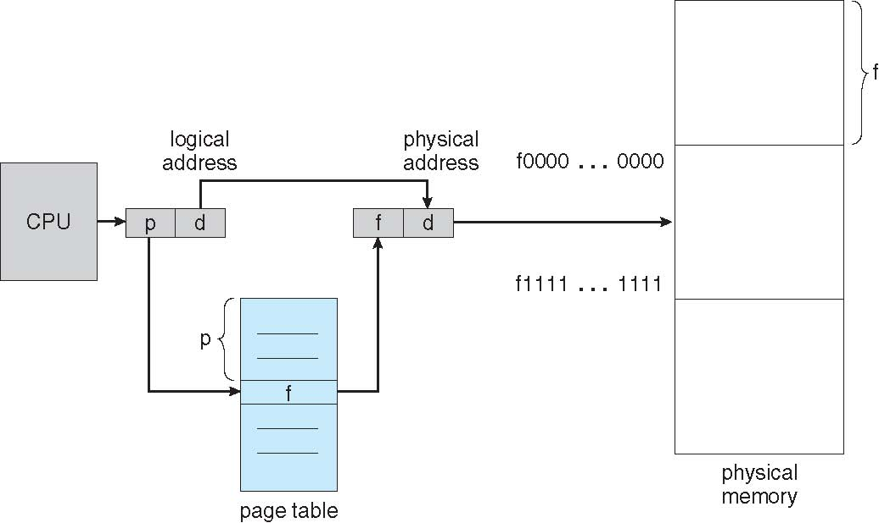
Paging Hardware

Slide 5
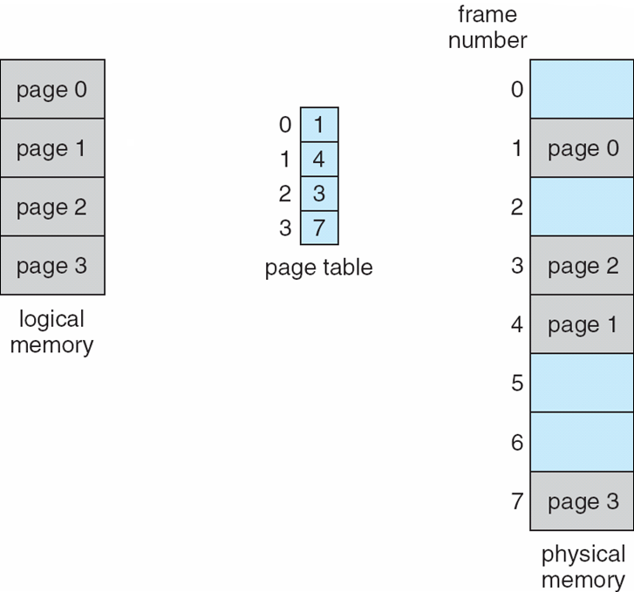
Paging Model of Logical and Physical Memory

Slide 6
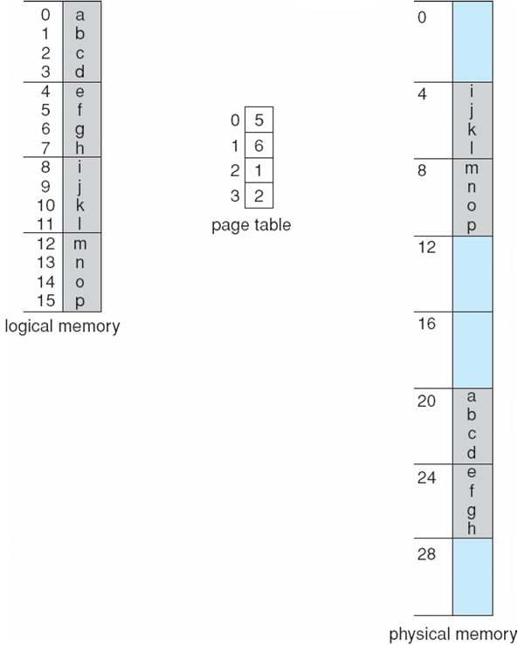
Paging Example
n=2 and m=4 32-byte memory and 4-byte pages

Slide 7
Paging (Cont.)
Calculating internal fragmentation
Page size = 2,048 bytes
Process size = 72,766 bytes
35 pages + 1,086 bytes
Internal fragmentation of 2,048 - 1,086 = 962 bytes
Worst case fragmentation = 1 frame – 1 byte
On average fragmentation = 1 / 2 frame size
So small frame sizes desirable?
But each page table entry takes memory to track
Page sizes growing over time
Solaris supports two page sizes – 8 KB and 4 MB
Process view and physical memory now very different
By implementation process can only access its own memory

Slide 8
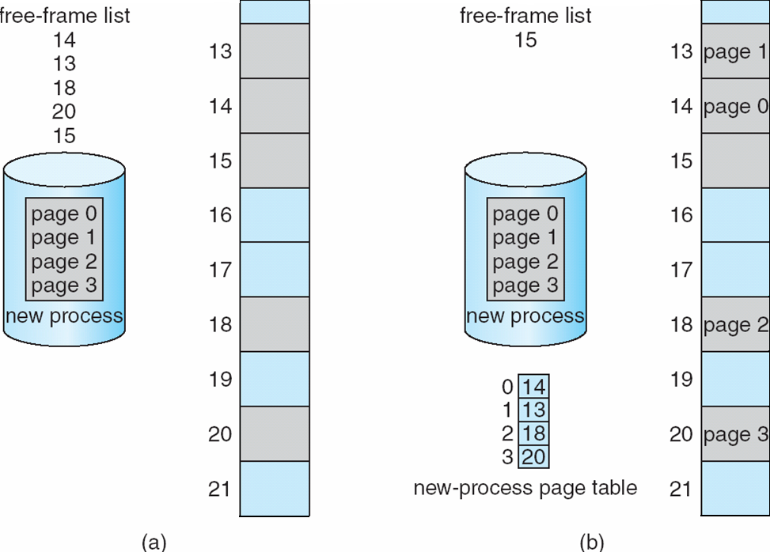
Free Frames
Before allocation
After allocation

Slide 9
Implementation of Page Table
Page table is kept in main memory
Page-table base register (PTBR) points to the page table
Page-table length register (PTLR) indicates size of the page table
In this scheme every data/instruction access requires two memory accesses
One for the page table and one for the data / instruction
The two memory access problem can be solved by the use of a special fast-lookup hardware cache called associative memory or translation look-aside buffers (TLBs)

Slide 10
Implementation of Page Table (Cont.)
Some TLBs store address-space identifiers (ASIDs) in each TLB entry – uniquely identifies each process to provide address-space protection for that process
Otherwise need to flush at every context switch
TLBs typically small (64 to 1,024 entries)
On a TLB miss, value is loaded into the TLB for faster access next time
Replacement policies must be considered
Some entries can be wired down for permanent fast access

Slide 11
Associative Memory
Associative memory – parallel search
Address translation (p, d)
If p is in associative register, get frame # out
Otherwise get frame # from page table in memory

Slide 12
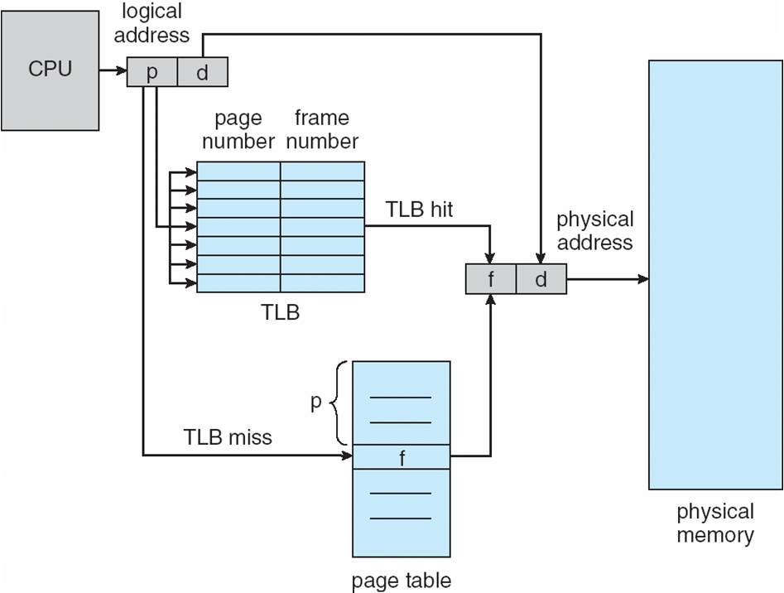
Paging Hardware With TLB

Slide 13
Effective Access Time
Associative Lookup = ε time unit
Can be < 10% of memory access time
Hit ratio = α
Hit ratio – percentage of times that a page number is found in the associative registers; ratio related to number of associative registers
Consider α = 80%, ε = 20ns for TLB search, 100ns for memory access
Effective Access Time (EAT)
EAT = (1 + ε) α + (2 + ε)(1 – α)
= 2 + ε – α
Consider α = 80%, ε = 20ns for TLB search, 100ns for memory access
EAT = 0.80 x 100 + 0.20 x 200 = 120ns
Consider more realistic hit ratio -> α = 99%, ε = 20ns for TLB search, 100ns for memory access
EAT = 0.99 x 100 + 0.01 x 200 = 101ns

Slide 14
Memory Protection
Memory protection implemented by associating protection bit with each frame to indicate if read-only or read-write access is allowed
Can also add more bits to indicate page execute-only, and so on
Valid-invalid bit attached to each entry in the page table:
“valid” indicates that the associated page is in the process’ logical address space, and is thus a legal page
“invalid” indicates that the page is not in the process’ logical address space
Or use page-table length register (PTLR)
Any violations result in a trap to the kernel

Slide 15
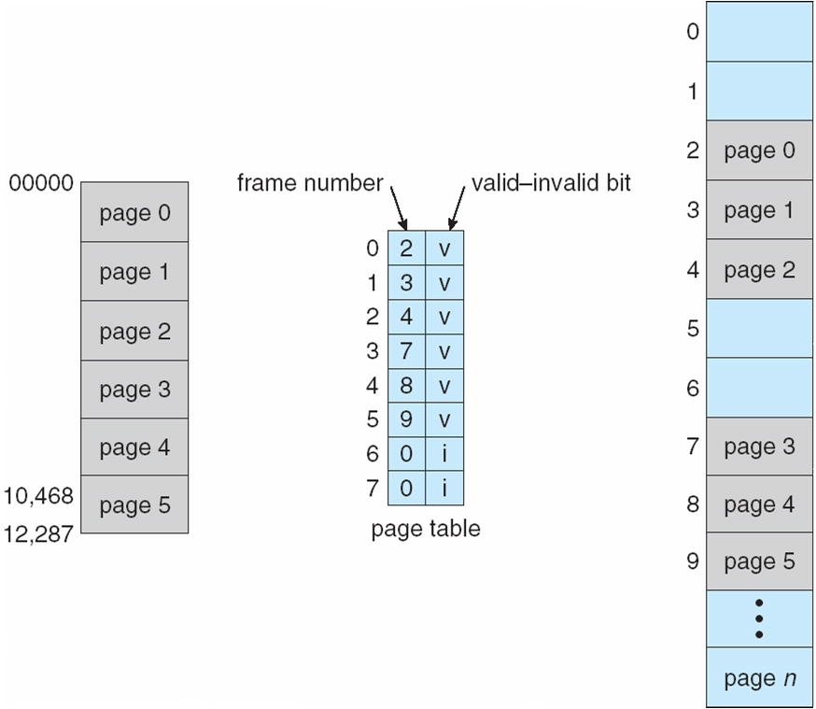
Valid (v) or Invalid (i) Bit In A Page Table

Slide 16
THANK YOU
Dr. K. Ramachandra Rao
Assoc. Prof., Dept. of C.S.E.
Shri Vishnu Engineering College for Women (A), Bhimavaram

